Slide 1
Introduction to Peripherals
Input Device: Keyboard

Slide 2
Computer Peripherals
  A peripheral is a piece of computer hardware that is added to a host computer in order to expand its abilities. More specifically, the term is used to describe those devices that are optional in nature, as opposed to hardware that is either demanded or always required in principle.
  The term also tends to be applied to devices that are hooked up externally, typically through some form of computer bus like USB.
  Some people do not consider internal devices such as video capture cards to be peripherals because they are added inside the computer case; for them, the term peripherals is reserved exclusively for devices that are hooked up externally to the computer

Slide 3
List of Some common peripherals
Input Devices:
Keyboard Digitizer
Mouse Digital Camera
Tackball Microphone
Joystick
Touch Screen
Scanner
Barcode Reader

Slide 4
List of Some common peripherals
Output Devices:
CRT Monitor,
Plasma display,
Video Projector,
Printer,
Plotter,
Speaker.

Slide 5
List of Some common peripherals
Storage Devices:
Magnetic Disk,
Compact Disk,
DVD,
Flash memory.
Other:
Modem, Display adapter, Sound card

Slide 6
Keyboard
A computer keyboard is a peripheral partially modeled after the typewriter keyboard. Keyboards are designed for the input of text and characters and also to control the operation of a computer.

Slide 7
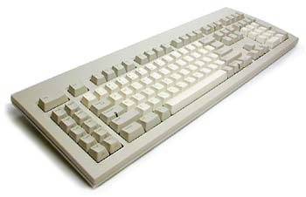
Keyboard
An average Windows keyboard

Slide 8
Keyboard
Physically, computer keyboards are an arrangement of rectangular buttons, or "keys". Keyboards typically have characters engraved or printed on the keys; in most cases, each press of a key corresponds to a single written symbol. However, to produce some symbols requires pressing and holding several keys simultaneously or in sequence; other keys do not produce any symbol, but instead affect the operation of the computer or the keyboard itself.

Slide 9
How it Woks?
The following briefly describes a "dome-switch" keyboard the most common type in use today
When a key is pressed, it pushes down on a rubber dome sitting beneath the key. A conductive contact on the underside of the dome touches (and hence connects) a pair of conductive lines on the circuit below.
This bridges the gap between them and allows current to flow (i.e. the circuit goes from open to closed), changing the signal strength.
A scanning signal is emitted by the chip along the pairs of lines to all the keys. When the signal in one pair becomes different, the chip generates a "make code" corresponding to the key connected to that pair of lines.

Slide 10
How it Woks? (Continued)
The code generated is sent to the computer either via a keyboard cable (using on-off electrical pulses to represent bits) or over a wireless connection. It may be repeated.
A chip inside the computer receives the signal bits and decodes them into the appropriate keypress. The computer then decides what to do on the basis of the key pressed (e.g. display a character on the screen, or perform some action).
When the key is released, a break code (different than the make code) is sent to indicate the key is no longer pressed. If the break code is missed (e.g. due to a keyboard switch) it is possible for the keyboard controller to believe the key is pressed down when it is not, which is why pressing then releasing the key again will release the key. (since another break code is sent.)
Other types of keyboards function in a similar manner, the main differences being how the individual key-switches work

Slide 11
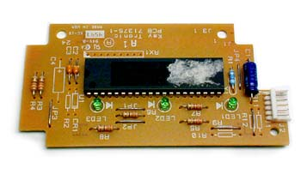
Inside the Keyboard
A keyboard is a lot like a miniature computer. It has its own processor and circuitry that carries information to and from that processor. A large part of this circuitry makes up the key matrix.
Fig. The microprocessor and controller circuitry of a keyboard

Slide 12
Inside the Keyboard (Continued..)
The key matrix is a grid of circuits underneath the keys. In all keyboards (except for capacitive models,), each circuit is broken at a point below each key. When you press a key, it presses a switch, completing the circuit and allowing a tiny amount of current to flow through. The mechanical action of the switch causes some vibration, called bounce, which the processor filters out. If you press and hold a key, the processor recognizes it as the equivalent of pressing a key repeatedly.

Slide 13
Inside the Keyboard (Continued..)
When the processor finds a circuit that is closed, it compares the location of that circuit on the key matrix to the character map in its read-only memory (ROM). A character map is basically a comparison chart or lookup table. It tells the processor the position of each key in the matrix and what each keystroke or combination of keystrokes represents. For example, the character map lets the processor know that pressing the a key by itself corresponds to a small letter "a," but the Shift and a keys pressed together correspond to a capital "A."

Slide 14
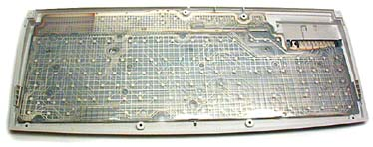
Inside the Keyboard (Continued..)
A computer can also use separate character maps, overriding the one found in the keyboard. This can be useful if a person is typing in a language that uses letters that don't have English equivalents on a keyboard with English letters.
Fig. The key matrix

Slide 15
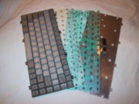
Keyboard technology
Fig. Keyboard construction, in four layers, of a typical notebook computer keyboard

Slide 16
Keyboard technology (Continued)
There are many types of keyboard, usually differentiated by the switch technology employed in their operation. Since there are so many switches needed (usually about 80-110) and because they have to be highly reliable, this usually defines the keyboard. The choice of switch technology affects key response (the positive feedback that a key has been pressed) and travel (the distance needed to push the key to enter a character reliably).

Slide 17
Keyboard technology (Continued)
Types
Dome-switch keyboard
Scissor-switch keyboard
Capacitive keyboard
Mechanical-switch keyboard
Hall-effect keyboard
Laser keyboard
Membrane keyboard

Slide 18
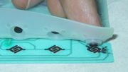
Dome-switch keyboard
How a dome-switch keyboard works: Finger depresses the dome to complete the circuit

Slide 19
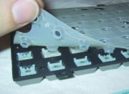
Dome-switch keyboard
Dome-switches mesh with keys (keyboard is upside down in this image)

Slide 20
Dome-switch keyboard
Rubber dome switches are very common. They use small, flexible rubber domes, each with a hard carbon center. When you press a key, a plunger on the bottom of the key pushes down against the dome, and the carbon center presses against a hard, flat surface beneath the key matrix. As long as the key is held, the carbon center completes the circuit. When the key is released, the rubber dome springs back to its original shape, forcing the key back up to its at-rest position. Rubber dome switch keyboards are inexpensive, have pretty good tactile response and are fairly resistant to spills and corrosion because of the rubber layer covering the key matrix.

Slide 21
Dome-switch keyboard
This type of switch technology happens to be most commonly used in handheld controllers, mobile phones, automotive, consumer electronics and medical devices. Dome-switch keyboards are also called direct-switch keyboards.

Slide 22

Scissor-switch keyboard
Scissor-switch technology does not use a rubber-plunger assembly like most other keyboards. Scissor-switch keyboards are normally responsive and crisp. These keyboards are generally quiet. The keys require little force to press.
This keyboard technology is mainly used in laptops.

Slide 23
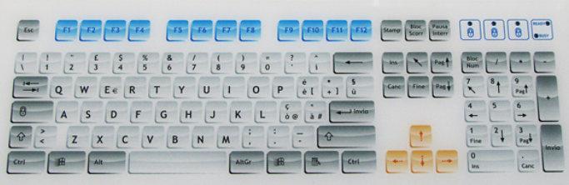
Capacitive keyboard
In this type of keyboard, pressing the key changes the capacitance of a pattern printed on a PC board. Usually this permits a pulse or pulse train to be sensed. Unlike "dome switch" keyboards, the pattern will be covered by a thin, insulating film. Capacitive keyboards are expensive, and resist wear, water, foreign objects and dirt. They are common in PC keyboards.

Slide 24
Capacitive keyboard (Continued)
Capacitive switches are considered to be non-mechanical because they do not physically complete a circuit like most other keyboard technologies. Instead, current constantly flows through all parts of the key matrix. Each key is spring-loaded and has a tiny plate attached to the bottom of it. When you press a key, it moves this plate closer to the plate below it. As the two plates move closer together, the amount of current flowing through the matrix changes. The processor detects the change and interprets it as a key press for that location. Capacitive switch keyboards are expensive, but they have a longer life than any other keyboard. Also, they do not have problems with bounce since the two surfaces never come into actual contact.

Slide 25
Mechanical-switch keyboard
Mechanical-switch keyboards use real switches, one under each key. Depending on the construction of the switch, these keyboards have varying responses and travel times. Notable keyboards utilizing this technology are the Apple Extended II, and its modern imitator, the Matias Tactile Pro. These two keyboards use ALPS switches. In India, the TVS Gold mechanical keyboard is very popular despite costing about five times a membrane keyboard.

Slide 26
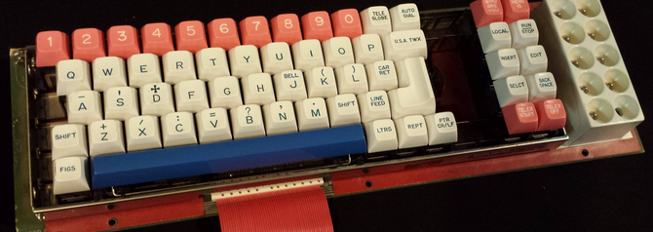
Hall-effect keyboard
Hall effect keyboards use magnets and Hall effect sensors instead of an actual switch. When a key is depressed, it moves a magnet, which is detected by the solid-state sensor. These keyboards are extremely reliable, and are able to accept millions of keystrokes before failing. They are used for ultra-high reliability applications, in locations like nuclear power plants or aircraft cockpits. They are also sometimes used in industrial environments. These keyboards can be easily made totally waterproof. They also resist large amounts of dust and contaminants. Because a magnet and sensor is required for each key, as well as custom control electronics, they are very expensive.

Slide 27
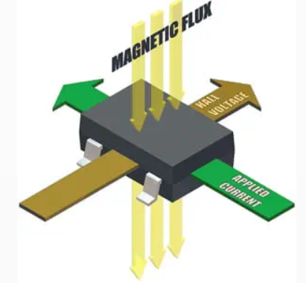
Hall Effect Switch
Generation of an electric potential perpendicular to both an electric current flowing along a conducting material and an external magnetic field applied at right angles to the current upon application of the magnetic field.

Slide 28
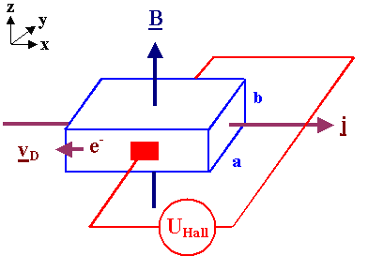
Hall Effect Switch
A magnetic field B is employed perpendicular to the current direction j, as a consequence a potential difference (i.e. a voltage) develops at right angles to both vectors.
The principle of the Hall effect states that when a current-carrying conductor or a semiconductor is introduced to a perpendicular magnetic field, a voltage can be measured at the right angle to the current path. This effect of obtaining a measurable voltage is known as the Hall effect.

Slide 29
Membrane keyboard
Rather than having a switch for each key, membrane keyboards use a continuous membrane that stretches from one end to another. A pattern printed in the membrane completes the circuit when you press a key. Some membrane keyboards use a flat surface printed with representations of each key rather than keycaps. Membrane keyboards don't have good tactile response, and without additional mechanical components they don't make the clicking sound that some people like to hear when they're typing. However, they're generally inexpensive to make.

Slide 30
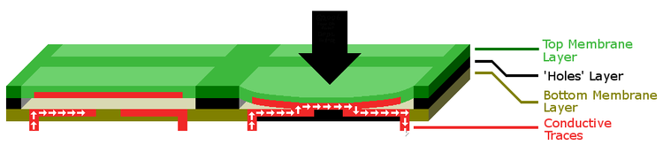
Membrane keyboard

Slide 31
Membrane keyboard
Consists of three layers:
  Two of these are membrane layers containing conductive traces.
  The center layer is a "spacer" containing holes wherever a "key" exists. It keeps the other two layers apart.

Slide 32
Membrane keyboard
Under normal conditions, the switch (key) is open, because current cannot cross the non-conductive gap between the traces on the bottom layer.
When the top layer is pressed down (with a finger), it makes contact with the bottom layer. The conductive traces on the underside of the top layer can then bridge the gap, allowing current to flow. The switch is now "closed", and the parent device registers a key press.
Mainly gaming keyboard, for its noiseless attitude.

Slide 33
Laser keyboard
A laser projection device approximately the size of a computer mouse projects the outline of keyboard keys onto a flat surface, such as a table or desk. When the laser is interrupted in the position of a key, a keystroke is registered. This type of keyboard is portable enough to be easily used with PDAs and cellphones. However, sudden or accidental disruption of the laser will register unwanted keystrokes. Also, if the laser malfunctions, the whole unit becomes useless, unlike conventional keyboards which can be used even if a variety of parts (such as the keycaps) are removed. This type of keyboard can be cumbersome to use since it is susceptible to errors, even in the course of normal typing, and its complete lack of tactile feedback makes it even less user-friendly than the cheapest membrane keyboards.

Slide 34
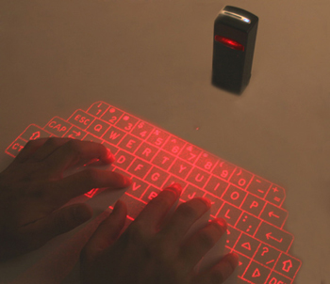
Laser keyboard
Fig. Laser keyboard

Slide 35
Other parts of the PC keyboard
The modern PC keyboard is more than just the switch technology, however. It also includes a control processor and indicator lights to provide feedback to the user about what state the keyboard is in. Depending on the sophistication of the controller's programming, the keyboard may also offer other special features.
The processor is usually a single chip 8048 microcontroller variant. The keyboard switch matrix is wired to its inputs and it processes the incoming keystrokes and sends the results down a serial cable (the keyboard cord) to a receiver in the main computer box. It also controls the illumination of the "caps lock", "num lock" and "scroll lock" lights.

Slide 36
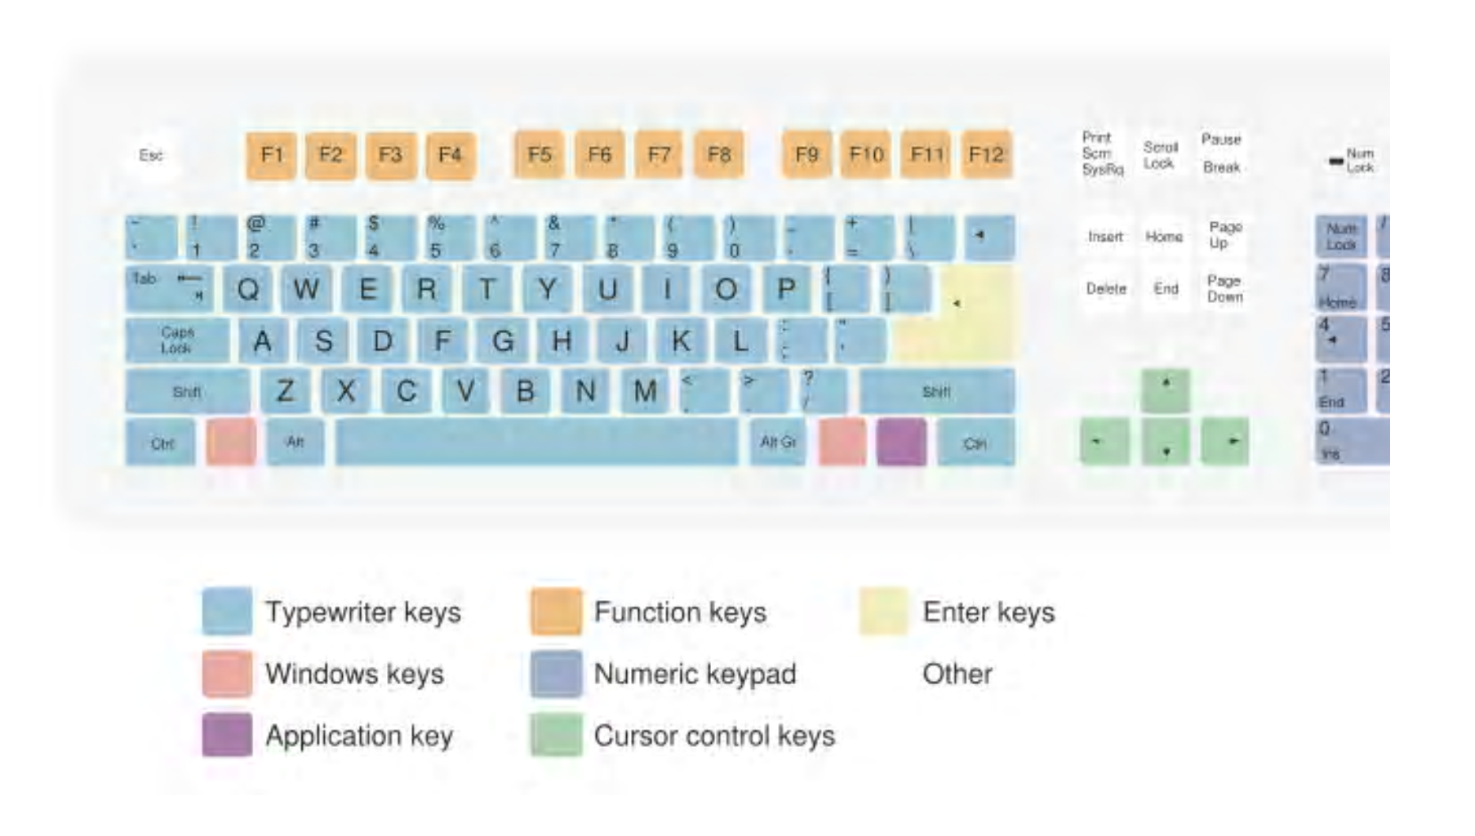
Keyboard Layout

Slide 37
Keyboard Layout (Continued)
There exist a large number of different arrangements of symbols on keys. These different keyboard layouts arise mainly because different people need easy access to different symbols; typically, this is because they are writing in different languages, but specialized keyboard layouts for mathematics, accounting, and computer programming also exist.

Slide 38
Keyboard Layout (Continued)
Most of the more common keyboard layouts (QWERTY-based and similar) were designed in the era of the mechanical typewriters, so their ergonomics had to be slightly compromised in order to tackle some of the technical limitations of the typewriters. QWERTY layouts and their brethren had been a de facto standard for decades prior to the introduction of the very first computer keyboard, and were primarily adopted for electronic keyboards for this reason. Alternative layouts do exist, the best known of which is the Dvorak Simplified Keyboard; however, these layouts are not in widespread use.
In principle, computer keyboard designs are governed by the ISO/IEC 9995 international standard.

Slide 39
Connection types
There are several different ways of connecting a keyboard which have evolved over the years. These include the standard AT (DIN-5) connector commonly found on pre-80486 motherboards, which was eventually replaced by the PS/2 and now USB connection. Prior to the iMac line of systems, Apple Computer used ADB, a proprietary system, for its keyboard connector

Slide 40
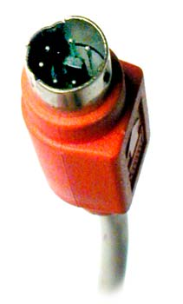
Connection types (Continued)
A PS/2 type keyboard connector

Slide 41
Connection types (Continued)
Wireless keyboards, on the other hand, connect to the computer through infrared (IR), radio frequency (RF) or Bluetooth connections. IR and RF connections are similar to what you'd find in a remote control. Regardless of which sort of signal they use, wireless keyboards require a receiver, either built in or plugged in to the USB port, to communicate with the computer. Since they don't have a physical connection to the computer, wireless keyboards have an AC power connection or use batteries for power

Slide 42
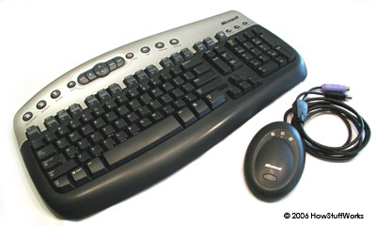
Connection types (Continued)
Microsoft wireless keyboard

Slide 43
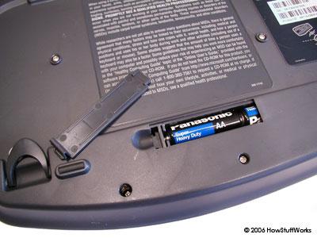
Connection types (Continued)
This Microsoft wireless keyboard is battery-powered.

Slide 44
Customization of keyboard
Sometimes, it is desired to customize the layout of a keyboard or remap the keys.
Under systems running X11 (e.g. GNU/Linux) this can be done with xmodmap, under Windows there are several software for this purpose :
SharpKeys: free
KeyTweak: free
Keyboard Layout Manager: commercial

Slide 45
Common Keyboard Terms
Actuation Point The distance at which the switch needs to depress to register as an input. Measured from the top of the keycap.
Reset Point: The distance at which the key needs to rebound for the switch to reset.
Tactile Point is the point during the keypress at which the bump occurs to indicate to your finger that the key has been actuated.
Key Blocking is when multiple keys are depressed simultaneously; your keyboard will not recognize future keystrokes until the original keys are lifted. Keyboards have a maximum number of keys it can register at one time and if you depress more than its limit, it won’t register the other key presses.

Slide 46
Common Keyboard Terms
Key Ghosting When pressing multiple keys simultaneously, a normal keyboard will ignore most of the keys pressed this is called “ghosting”. While a keyboard with anti-ghosting will take all (or most) of them to notice and use them..
Key Rollover is the number of keys that can be pressed in succession without having to lift a finger from any of the previous keys. Keyboards use the term KRO to represent the maximum number of keys you can press without experiencing any key blocking. So a 3KRO keyboard is a keyboard that can register 3 keys being pressed at once without experiencing key blocking.

Slide 47
Common Keyboard Terms
NKRO refers to N-Key Rollover, the ultimate in keyboards. A keyboard with N-Key Rollover can register as many keys as you can press at once without any key blocking issues. Currently, this feature is only available in keyboards with PS/2 connectors.

